Slide 1
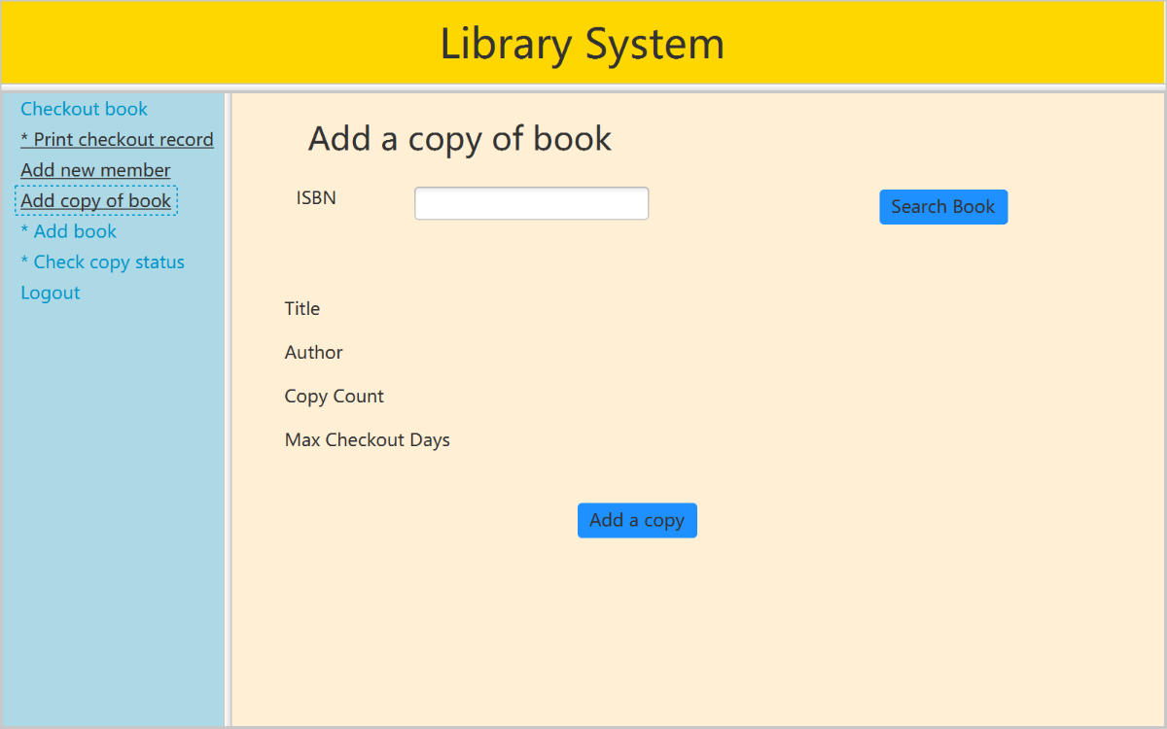
Project Assignment Group1
Member:
Yanjun Jiang
Xiangkui Guo
Huan Wang

Slide 2
Outline
Use Case Model
Final Class Model
Sequence diagram
Validation Rules of UI Windows
Conclusion with SCI Knowledge

Slide 3
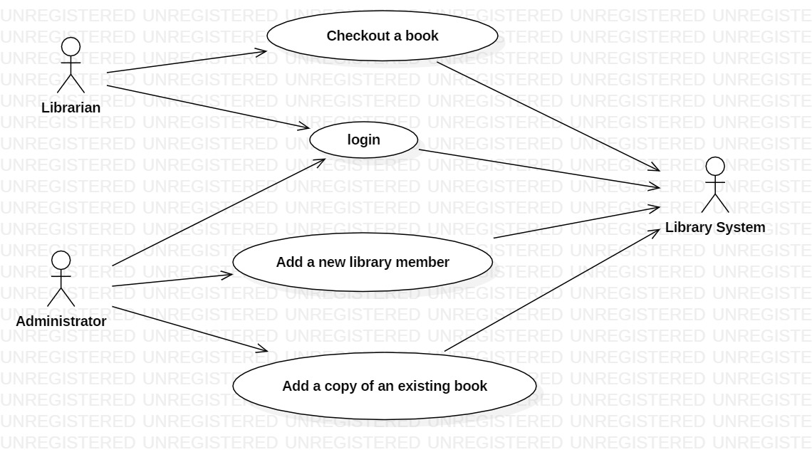
Use Case Model (Basic)

Slide 4
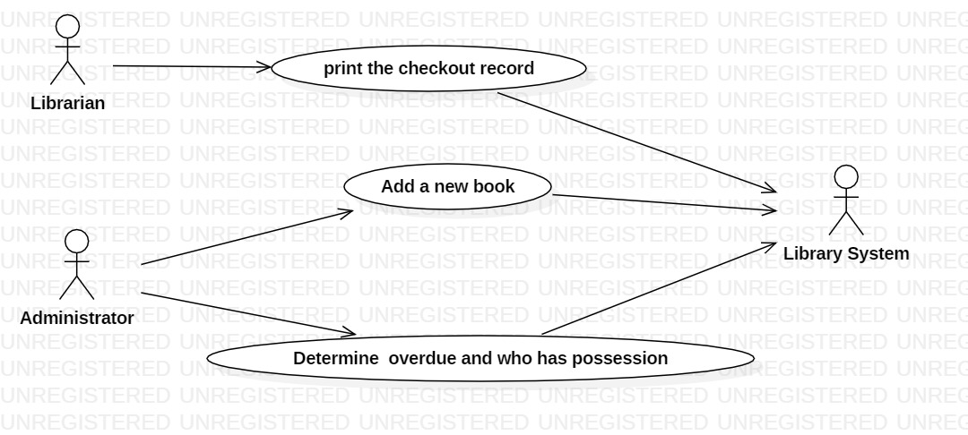
Use Case Model (Optional)

Slide 5
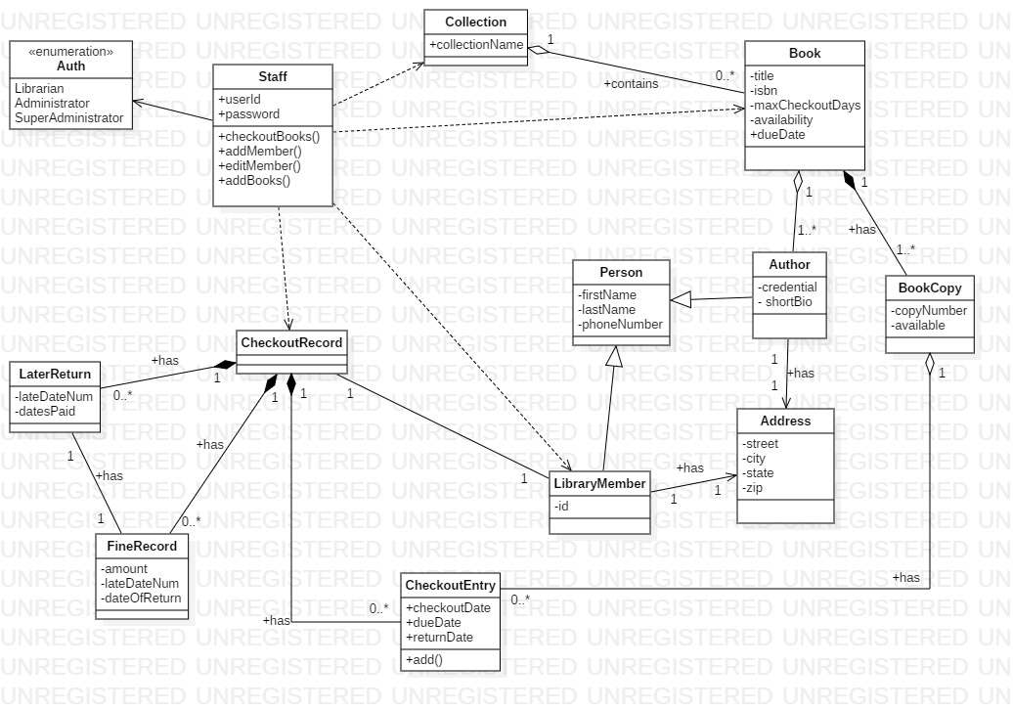
Final Class Model

Slide 6
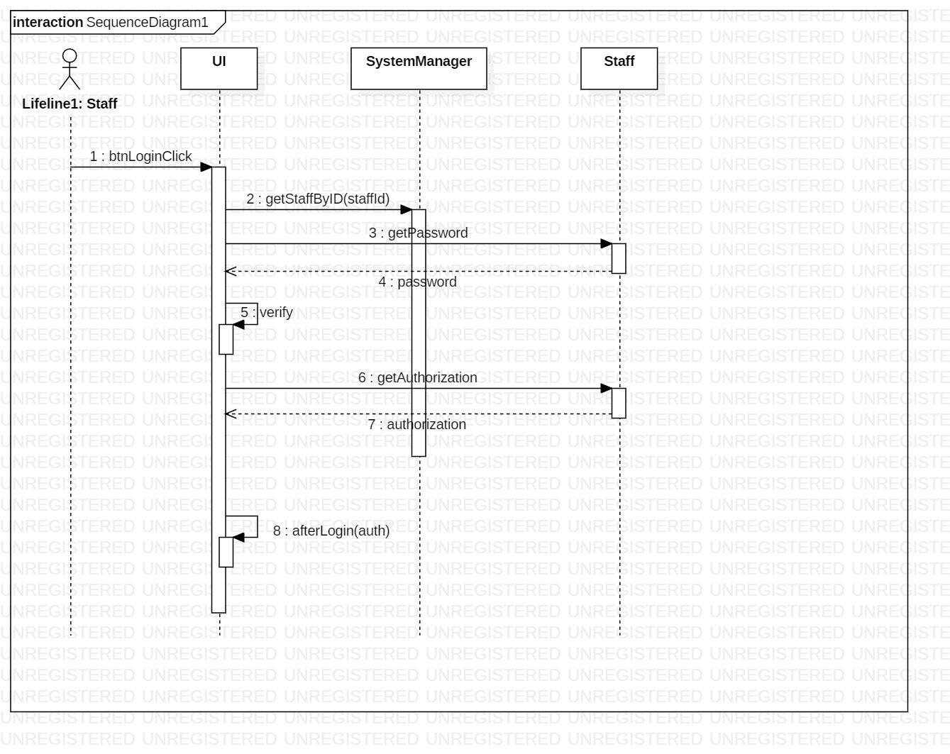
Sequence diagram (Login)

Slide 7
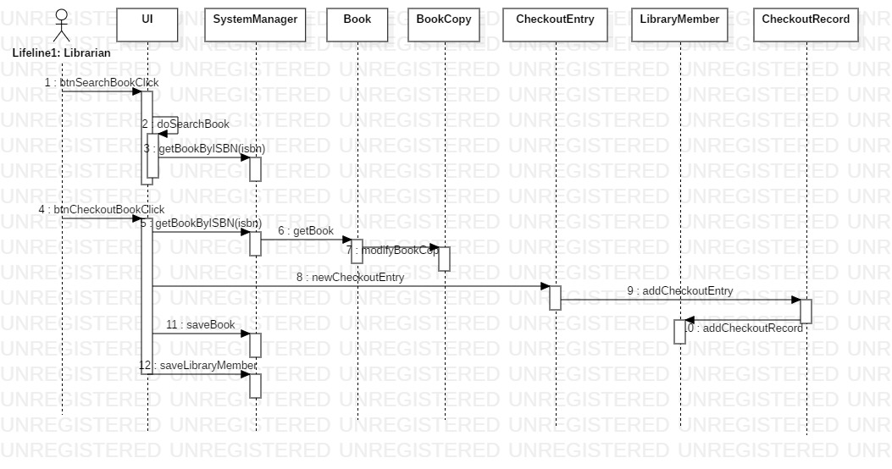
Sequence diagram (Checkout a book)

Slide 8
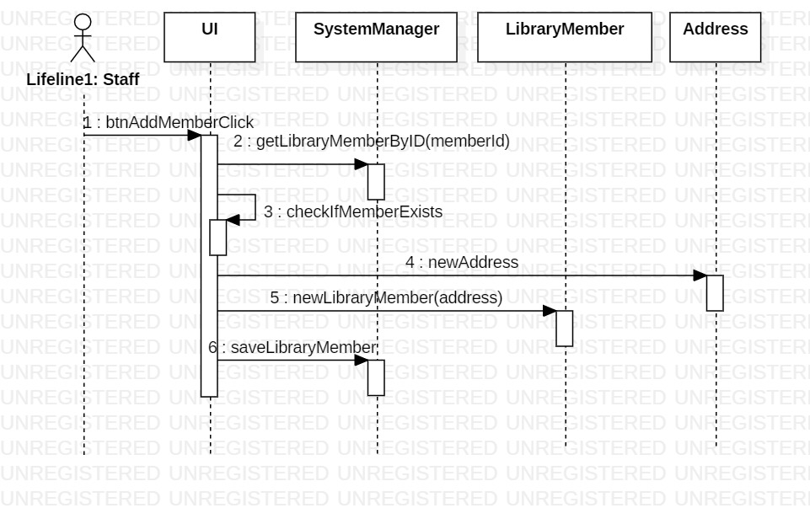
Sequence diagram (add a new Member)

Slide 9
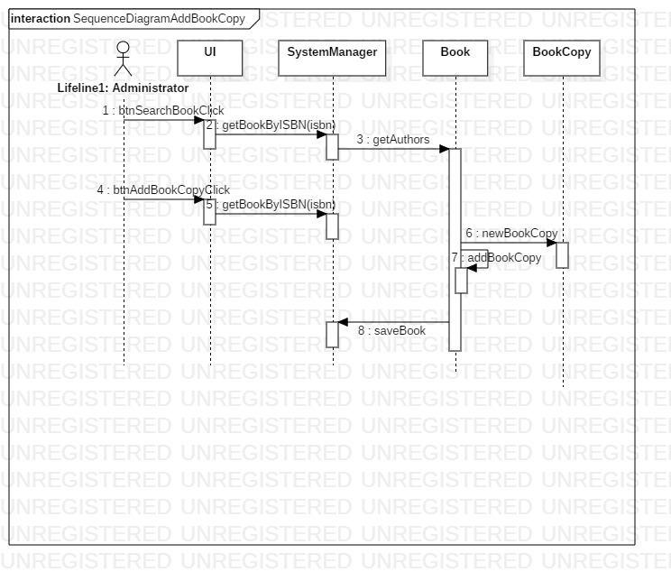
Sequence diagram (Add a copy of an existing book)

Slide 10
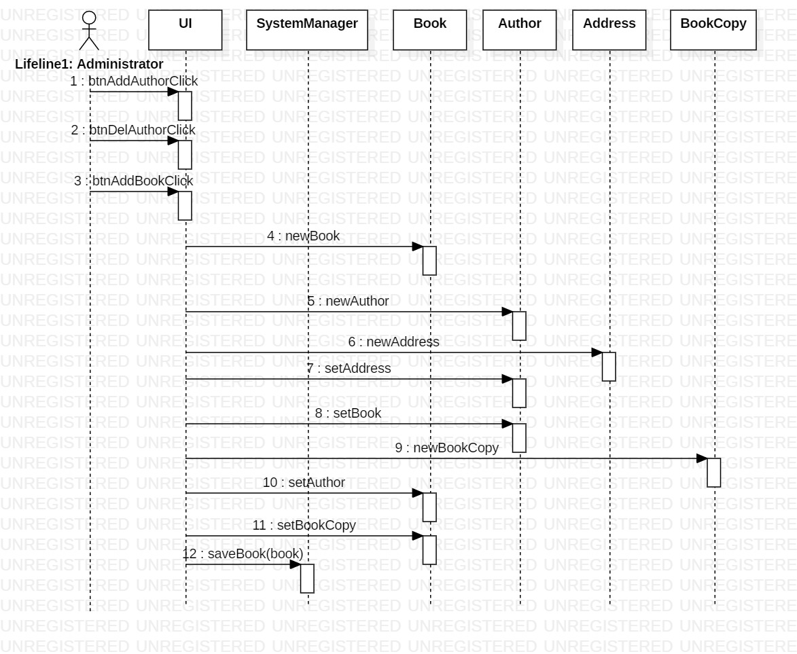
Sequence diagram (* Add a new book)

Slide 11
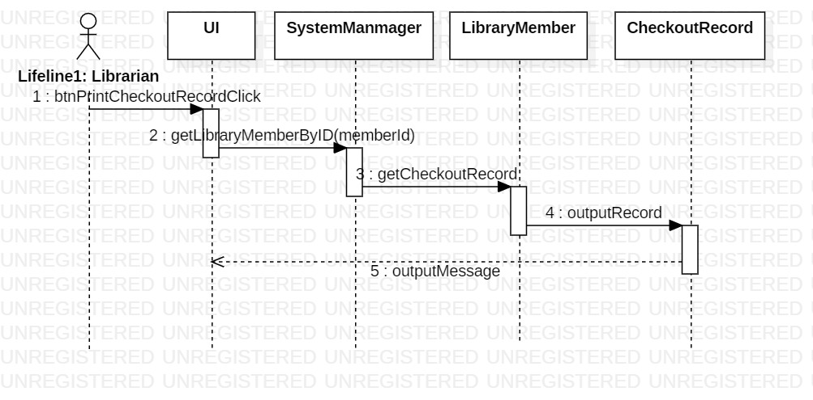
Sequence diagram (* Print checkout Record)

Slide 12
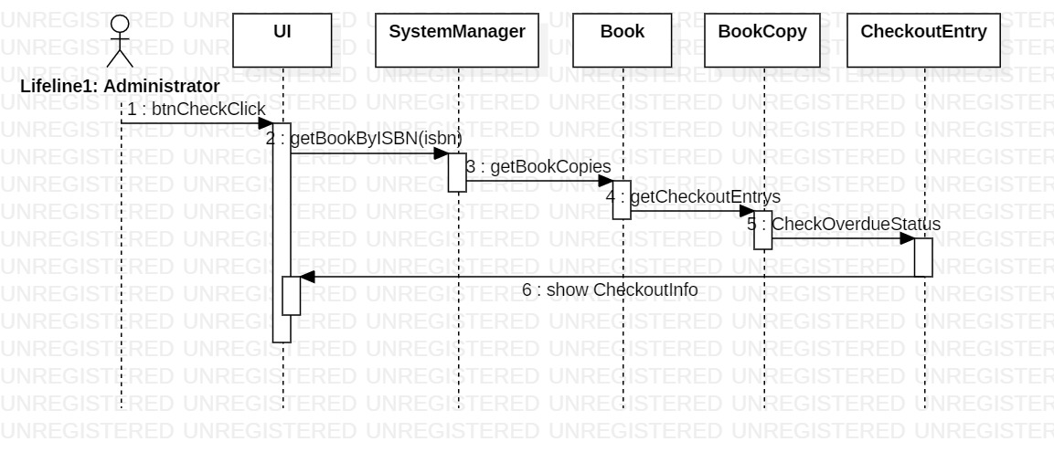
Sequence diagram (* Determine overdue and the possession)

Slide 13
Validation Rules of UI Windows
Book’s ISBN and title must be entered and ISBN must be number
User Id could be any character
Member’s id, first Name, last Name must be entered
After save an object to file, show message to UI
Address’s street must be entered, zip must be number, tel Number must be number
Before save a data, check if the same key data exists, avoid duplication

Slide 14
Conclusion with SCI Knowledge
In our UI design, we will give response to every user’s action, this follows a principle of SCI -- Each action has a reaction
We finished this project with 3 members, our teamwork produced great outcome, far better than one person could archive. This proved one of the principles of SCI — The whole is greater than the sum of the parts.

